Slide 1


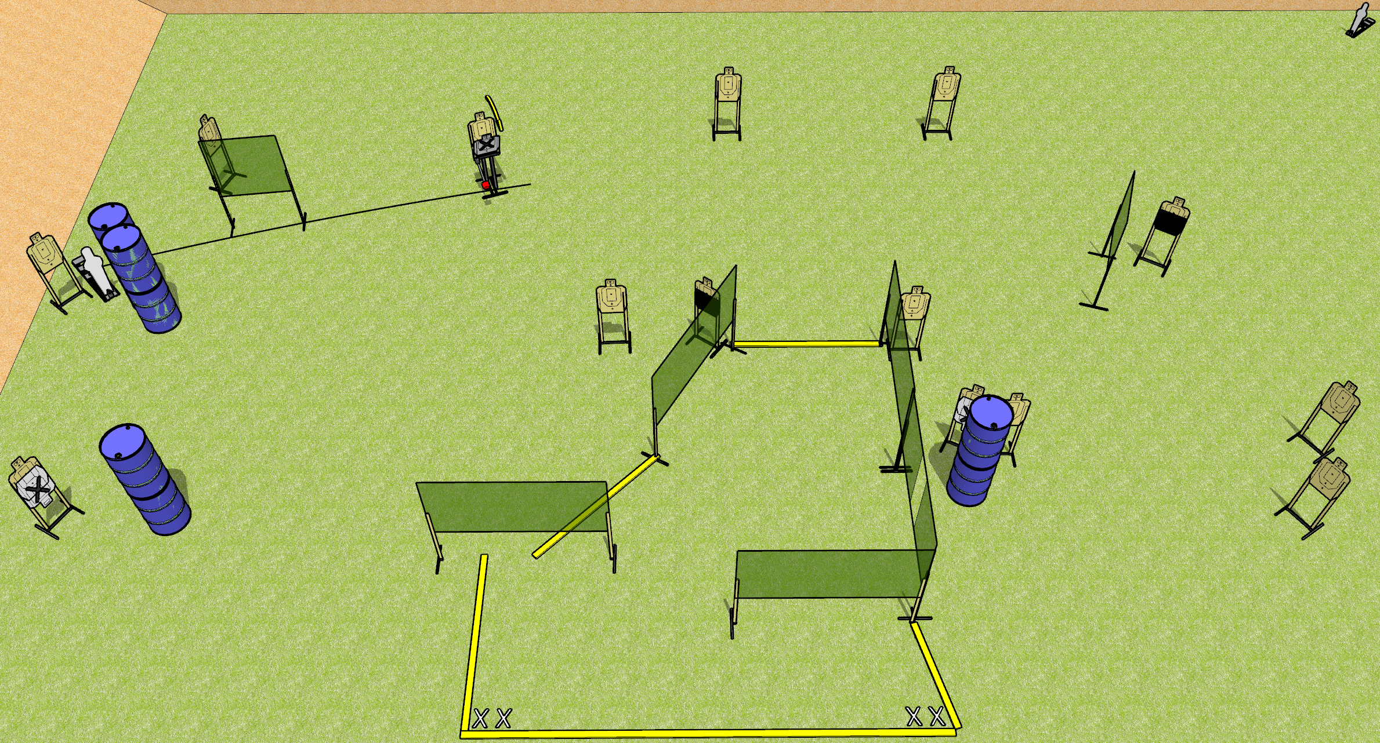
 | Dothan Gun Club – USPSA Match Mixtape Course Designer : Drew Coleman
30 rounds 14 USPSA 1 mini popper, 1 pepper popper
Equipment List 12 wall feet Max trap + activator 2 50% hard cover, consider mixing a tuxedo or 2 in SETUP NOTE: check stage flow and consider omitting the far-right small wall next to the hard cover

Slide 2
Mixtape
Written Stage Briefing
Mixtape is a 30 round, 150 point, Comstock field course. There are 14 USPSA targets, 1 pepper popper, and 1 USPSA mini popper. The best 2 hits on paper will score, and steel must fall to score. The start signal is audible.
The max trap is activated by the pepper popper, and is not a disappearing target. Please check the activator prior to walkthrough and set it the same way every time.
Handgun start position is both feet on either set of X’s, wrists below belt. Handgun is loaded and holstered.
PCC start position is both feet on either set of X’s. Loaded carbine is held with both hands, stock on belt, safety on.
On start signal, engage targets as they become available from within the shooting area.

